Slide 1
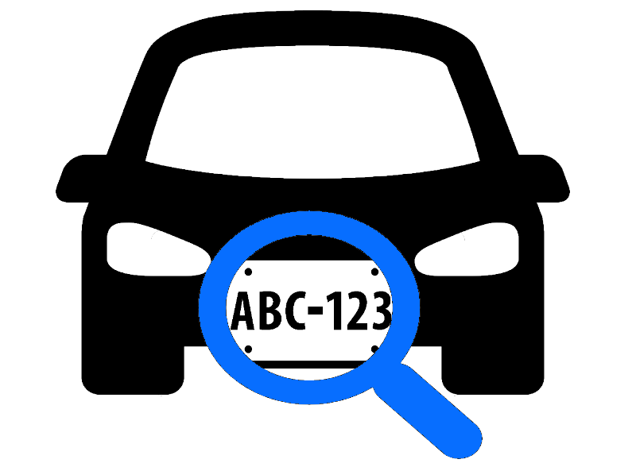
License Plate Detection
Team
Koushik Pabbathireddy -Grad
Sanjana Peddi -Grad
Pravallika Putti -Grad
Ariana Whitaker-Undergrad

Slide 2
License Plate Detection
Team
Koushik Pabbathireddy -Grad
Sanjana Peddi -Grad
Pravallika Putti -Grad
Ariana Whitaker-Undergrad

Slide 3
Introduction
License Plate Recognition is a software which is used to perform Optical Character Recognition on images of cars which contains the license plate
As how the human vision does ,in the same way Computer Vision also attempts to see, identify, and process images but instead of dealing with datasets they deal with images .
Computer Vision will be used to find out what a license plate looks like from the given images, videos of cars and how to detect one.
The primary target for the project is to train a model which detects a number plate from an image and draws a bounding box over it. This box is used to extract the number plate information using OCR which can be used for multiple purposes.

Slide 4
Introduction

Slide 5
Problem and Motivation
With the popularization of automobiles and the progress of computer vision detection technology, intelligent license plate detection technology has gradually become important for intelligent traffic management
License plate detection is used to segment vehicle image and obtain license plate area for follow-up recognition system to screen. It is widely used in intelligent traffic management, vehicle video monitoring and other fields
Addd motivation

Slide 6
Dataset
We have a huge data set of 400 images and 400 XML files.
Our model is trained using the data set of images and XML files.
The Inputs given to model are Car images with number plate and XML files defining the location of the number plates using dimensions.
We have provided an image to the model to predict the Bounding box covering the number plate .
We have split the Data 80 percentage of it to train and 20 percentage to test the model.
We also used 10 percentage of Training Data to validate the model by itself in the process of training which is special input argument for a Keras model.

Slide 7
Literature Review VGG16
We used the VGG-19 which is a convolutional neural network
ImageNet, a massive visual database project utilized in visual object recognition software research, uses VGG16, a simple and widely used Convolutional Neural Network (CNN) Architecture. Karen Simonyan and Andrew Zisserman of the University of Oxford created and launched the VGG16 Architecture in their essay "Very Deep Convolutional Networks for Large-Scale Image Recognition" in 2014.
The term 'VGG' stands for Visual Geometry Group, a group of scholars at the University of Oxford who designed this architecture, and the number '16' indicates that there are 16 layers in this architecture.
In ImageNet, a dataset of over 14 million images belonging to 1000 classes, the VGG16 model obtained 92.7 percent top-5 test accuracy.

Slide 8
Methodology
Car photos with number plates and XML files describing the placement of the number plates using dimensions are given to the model as inputs.
When an image is submitted to model, it gives the estimated coordinates of the rectangular number plate as an output.
The model is a sequential model.We have 6 layers in the model out which the VGG16 layer is the most important one which can give upto 138 trainable parameters. I have briefly mentioned about VGG16 in Literature Review.
We have 4 dense layers and one flatten layer.Dense layer is utilized in the activation function for a desired output. Flatten layer is utilized for converting the multi dimensional output to single dimension for better flexible usage of output.

Slide 9
On a whole we have 17,099,140 parameters which is nothing but weights which increases the efficiency of the model by using forward process.
We have calculated the loss and Cost function for each epoch iteration. The loss we calculated is mean_squared_error.
The average squared difference between observed and expected values is calculated. The MSE equals zero when a model has no errors. Its value rises as the model inaccuracy rises.
We utilized 'adam' optimizer as it has highest efficiency over all optimizers.
We used a Batch size of 32.
We have metrics like Accuracy to evaluate the model.

Slide 10
Results
We have achieved a very good Accuracy of which shows us that the model will be able to detect the number plate from an image provided.
The Accuracy is calculated by comparing X_test and its predicted values which is Y_test

Slide 11
Conclusion

